Slide 1



Video Game Recommender
Project 4 Group 11

Slide 2




Meet Our Team
Tyler Beringer
Machine Learning Model
Jason Johnson
Tableau Visualizations
Brian Marowsky
Tableau Visualizations
Noah Stevens
Data Cleaning & Flask App

Slide 3

Inspiration and Purpose
Playing video games is something most of us all enjoy in our spare time
Explore and analyze player data to identify trends further tailored suggestions in the video game industry
Predict trends in the industry

Slide 4


Dataset
The dataset started with over 16,000 games, but during the data cleaning process it was narrowed down to just 7,900 games! (50% loss of games!)
The reduction was caused by
games without a review score.
There means there are a lot of
potentially underrated games out there!

Slide 5


Research Questions
Correlations between Sales Vs Genre?
Correlations between Critic Scores and Most Popular Game Publisher?
What are the most popular games?
Who is the top publisher?
Which genres get the most attention?

Slide 6

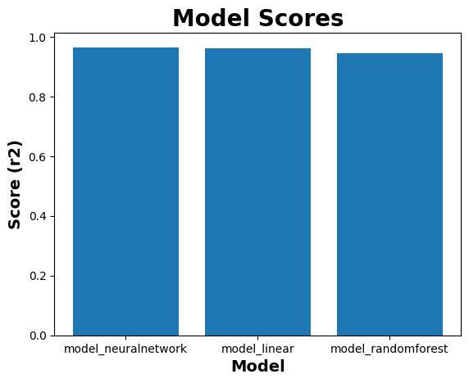
Machine Learning Model
Models:
Neural Network model
Linear model
Tree (specifically: random forest) model
Column to predict:
Global Sales
Model performance
A score of 1 meaning "accurate,"
all of the models passed the goal of 0.80
Neural Network R² score: 0.96
Linear R² score: 0.96
Tree (random forest) R² score: 0.94

Slide 7


Application Demo

Slide 8




Game Score
The highest Critic Score of 99/100 is “The Legend of Zelda Ocarina of Time” on the Nintendo 64 platform.
In a three-way tie for 2nd with a Critic Score of 98/100 are: “Tony Hawk’s Pro Skater 2” for the PlayStation 1 platform, “Soul Calibur” for the Sega Dreamcast platform and “Grand Theft Auto IV” for the XBox 360 and PlayStation 3 platforms

Slide 9

Top Developer
The number one publisher for this video game dataset is Electronic Arts. Some of the top titles are: FIFA 16 for PS4, FIFA Soccer 13 for PS3 and The Sims 3 for PC. In 2nd is Activision with notable titles such as: Call of Duty: Modern Warfare 3 for X360, Call of Duty: Black Ops 3 for PS4 and Call of Duty: Black Ops for X360 and in 3rd is Ubisoft with their “Just Dance” series 1-4 for the Nintendo Wii.

Slide 10
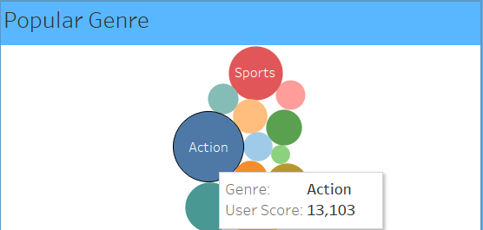
Popular Genre
Action genre is the most popular with a User Score of 13,103 which is let by The Legend of Zelda: Ocarina of Time on the Nintendo 64 platform, Grand Theft Auto IV for the X360 & PS3 and Grand Theft Auto V for X360 & PS3

Slide 11

Conclusions
Globally, PlayStation 2 was the most popular platform
Electronic Arts (EA) is the Top Game Developer with Sports being the most popular game genre

Slide 12

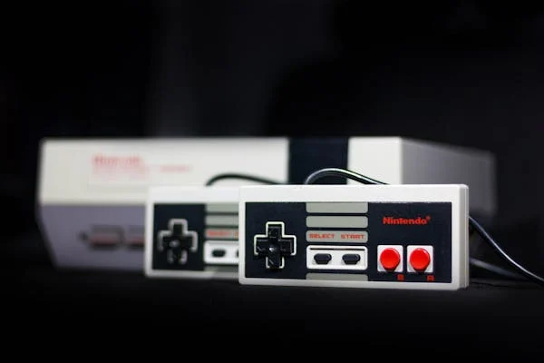
Biases and Limitations
Data set did not included actual prices for video games. Only gave per million copies sold.
Does Not include variables such as subscription 3rd party downloads
Data set categorized DLC content as stand alone video game vs add on to original game.

Slide 13


Future Work
Train a model that predicts Global Sales without other sales data (NA Sales, EU Sales, etc.)

Slide 14

Sources
Images
-https://www.pexels.com/search/video%20game/
- metacritic logo, wink emoji, earth, sales
Data sets-https://www.kaggle.com/datasets/rush4ratio/video-game-sales-with-ratings
https://www.kaggle.com/datasets/deepcontractor/top-video-games-19952021-metacritic
https://www.kaggle.com/code/maxkliment/video-games-predicting-global-sales
https://github.com/martabaker/ds_project_4_group_02

